Slide 1

Nutrition and Resistance to Infection
Medical and Political Responses in Interwar Years
Josep L. Barona
Instituto de Historia de la medicina y de la Ciencia
Universitat de València
Food and Nutrition in 19c & 20c Europe Conference
University of Sussex 12-13 May 2016

Slide 2
Food and Nutrition in 19c & 20c Europe Conference University of Sussex 12-13 May 2016
Calorie Organic energy
Balanced diet Nutrients
protein, fat, carbohydrate, mineral, vitamin
Optimum tissue performance Immunity
Infection
Microbe Immunity Environment

Slide 3
Food and Nutrition in 19c & 20c Europe Conference University of Sussex 12-13 May 2016
Deficiency Diseases associated with Nutrition
Rickets, beriberi, pellagra, anaemia, cretinism, hunger oedema, polyneuritis, scurvy
Chronic slight deficient nutrition Pre-pathological conditions
(poor nutrition) Infection

Slide 4

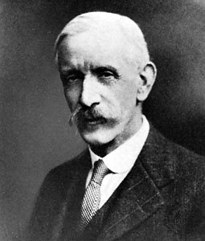
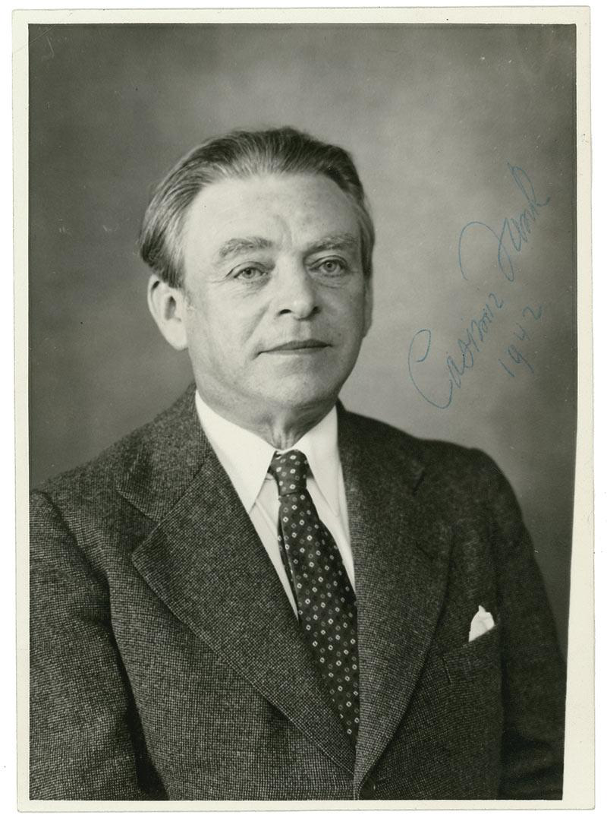
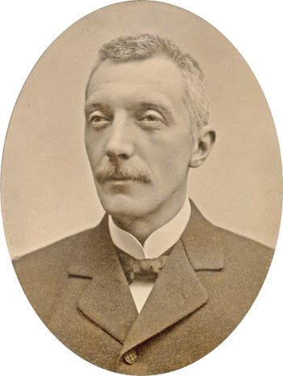

Food and Nutrition in 19c & 20c Europe Conference University of Sussex 12-13 May 2016
Macronutrients: protein, carbohydrate, fat
protective minimal qualitative accessory
food factors
Micronutrient
Vitamin
Ch. Eijkmann
F.G. Hopkins
A. Holst Th. Fröhlich Casimer Funk

Slide 5
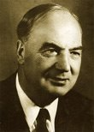
Food and Nutrition in 19c & 20c Europe Conference University of Sussex 12-13 May 2016
Slight low-vitamin intake not clinically evident deficiency
impairment of health diminish resistance to infection
Research on Vitamin A and Vitamin D
Cod Olive Oil nutritional supplements
Popularisation R. H. A. and V. Plimmer’s Food, Health and Vitamins (1928) E. Carrasco Cadenas, Ni gordos no flacos. Lo que se debe comer (1923)
Edward Mellanby

Slide 6
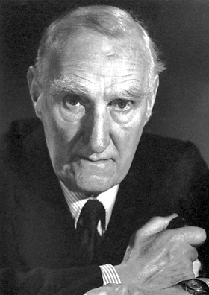
Food and Nutrition in 19c & 20c Europe Conference University of Sussex 12-13 May 2016
1940s: From Vitamins to Minerals
John Boyd Orr Rowett Institute (Aberdeen, Scotland):
"It is very probable that a long-continued wrong balance of minerals in the food, or a sudden change in the mineral content of the intestines ... may produce such a condition that infective organisms, normally kept from entering the blood stream, are allowed to pass through and produce acute disease."

